Slide 1
Strongly-Typed Views

Slide 2
A Strongly Typed view means it has a ViewModel associated to it that the controller is passing to it and all the elements in that View can use those ViewModel properties.
You can bind any class as model to view. You can access model properties on that view. You can use data associated with model to render controls.
There are three ways to pass information from a controller to a view in ASP.NET MVC
As a strongly typed model object.
As a dynamic type (using @model dynamic)
Using the ViewBag

Slide 3
It is an aspx page that derives from System.Web.Mvc.ViewPage<TModel>. It is said that this view is strongly typed to the type TModel. As a consequence to this there's a Model property inside this view which is of type TModel and allows you to directly access properties of the model like this:
  <%= Model.Name %>
  <%= Model.Age %>
consider an example : to compare and contrast dynamic and strongly typed view. The controller starts out with a simple list of blogs.

Slide 4
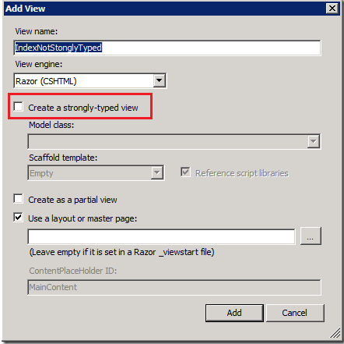
1 .Not Strongly Typed
Right click in the IndexNotStonglyTyped() method and add a Razor view.

Slide 5
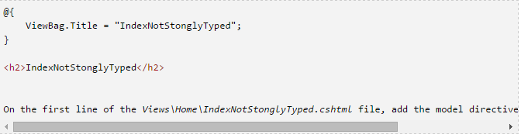
1 .Not Strongly Typed
Make sure that Create a strongly-typed view box is not checked. The resulting view doesn’t contain much:

Slide 6
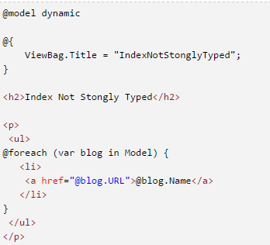
1 .Not Strongly Typed
Because we’re using a dynamic and not a strongly typed view, intelligence doesn’t help us. The completed code is shown below:

Slide 7
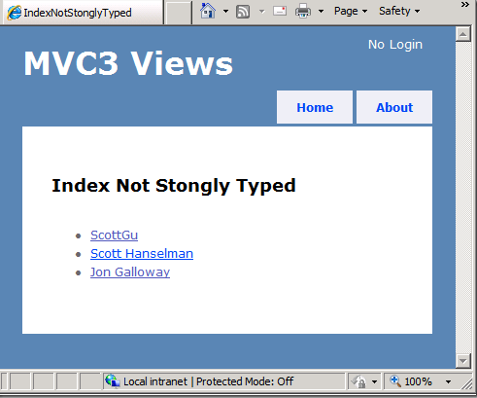
1 .Not Strongly Typed

Slide 8

2. Strongly Typed
Now we’ll add a strongly typed view. Add the following code to the controller:
Notice it’s exactly the same return View(topBlogs); call as the non-strongly typed view. Right click inside of StonglyTypedIndex() and select Add View. This time select the Blog Model class and select List as the Scaffold template.

Slide 9
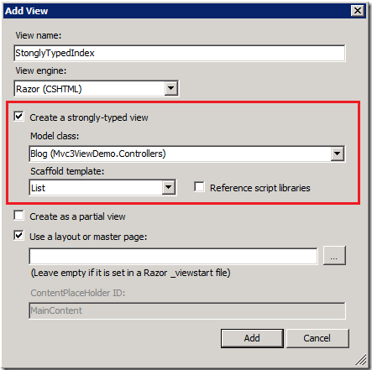
2. Strongly Typed

Slide 10
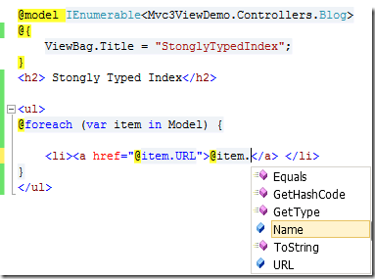
2. Strongly Typed
Inside the new view template we get intellisense support.

Slide 11
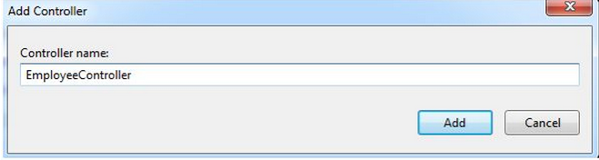
2. Strongly Typed - Example
1.Create a MVC project from the "Empty" template.
2.Right-click on "Models", select "Add" >> "Class…".
3.Name the class "Employee" and click on the "Add" button.
4.In the employee class create employee properties like EmployeeId, FirstName, LastName and so on.
5.Now add a controller; right-click on "Controllers", select "Add" >> "Controller…".

Slide 12
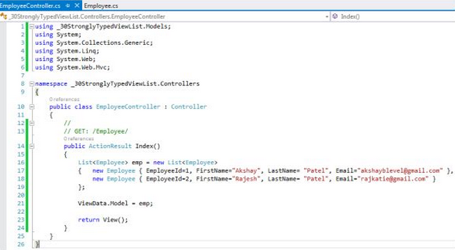
2. Strongly Typed - Example
6.In the Index action result method:
7.Create a list of employees with some dummy employee details
8.Assign the list to ViewData.Model

Slide 13
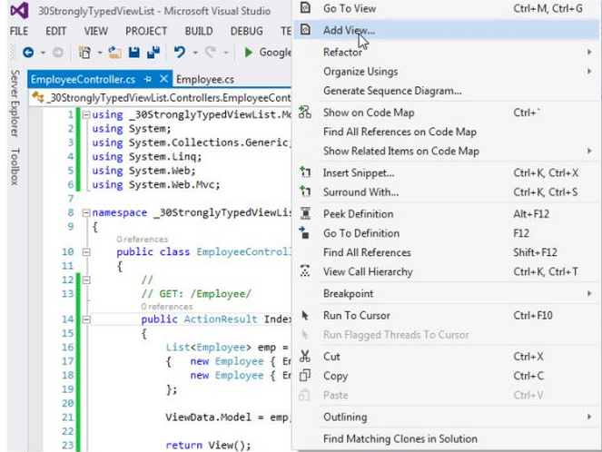
2. Strongly Typed - Example
9.Now add a view. Right-click on the "Index" action method and select "Add View…"

Slide 14
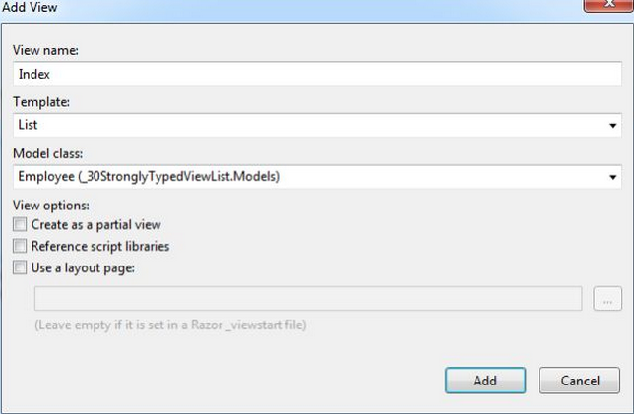
2. Strongly Typed - Example
10.Name the view as "Index".
Since we will show a list of employees, select "List" from the template.
From the model class drop down, select "Employee" as model.
Click on the "Add" button.

Slide 15
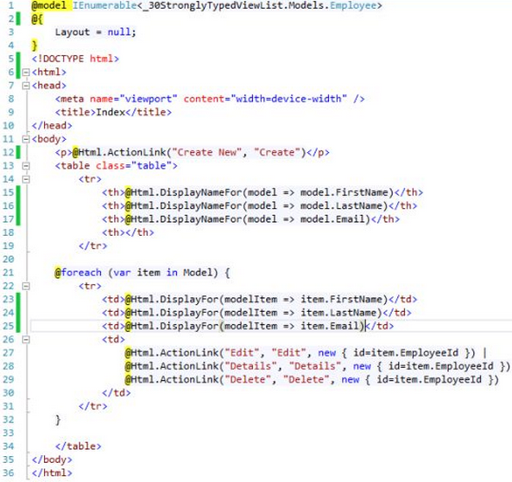
2. Strongly Typed - Example
11.It will automatically create a view from the model.

Slide 16
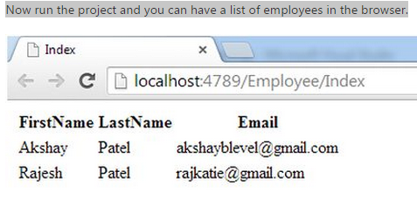
2. Strongly Typed - Example
12. Now run the project and you can have a list of employees in the browser.

